Slide 1
19CSE305: MACHINE LEARNING Lecture 1_P2
References: Towards data science, Machine Learning Mastery, Textbooks

Slide 2
Agenda
Machine Learning : What , Why?
Real world Examples

Slide 3
What is common in all these?

Slide 4
What is common in all these?
Machine learning replicate activities requiring human cognition
PC: Google Images

Slide 5
More Examples…..

Slide 6
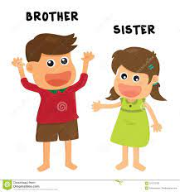
What is Machine Learning?
Me
Parry
Let’s Learn Machine Learning with Parry and her brother

Slide 7
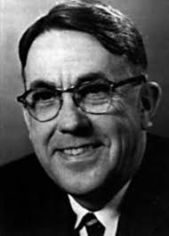
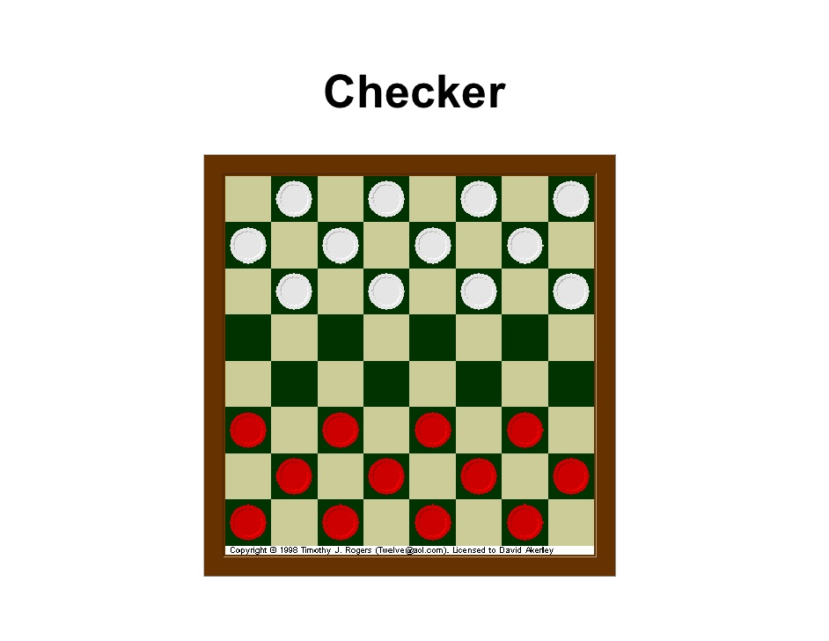
What is Machine Learning?
Arthur Samuel(1959):
"the field of study that gives computers the ability to learn without being explicitly programmed."
This is an older, informal definition.

Slide 8
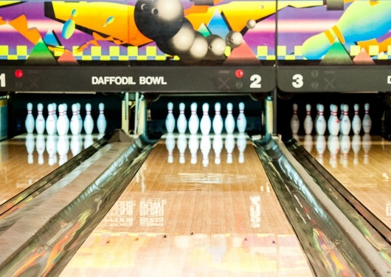
What is Machine Learning?
Me
Parry
Parry: Well, that’s the buzz word everyone is talking about. Can you please let me know what it is all about machine learning?
Me: Machine Learning is learning from data.
Parry: Learning from data? I don’t get it. You are talking to a layman so please talk in simpler terms.
Me: Imagine you are going to bowling and its your first day, so what do you think how will you perform?
Parry: I think very bad, I remember the first time I bowled I threw all the balls in the gutter.
Me: And what about today?

Slide 9
What is Machine Learning?
Me
Parry
Parry: Well, today I think I can easily drop at least 7 in one shot. But what this has to with machine learning?
Me: I’ll explain, but how did you improve your game?
Parry: Well, its simple. I practiced and with time I got experience, I got to know that I need to adjust the angle at which I am throwing the ball. Also I need to pick a lighter ball for better accuracy.
Me: Well, so over time you got experience by tweaking some parameters and your game improved. Right? This is machine Learning.

Slide 10
What is Machine Learning?
Herbert Alexander Simon:
“Learning is any process by which a system improves
performance from experience.”
“Machine Learning is concerned with computer programs that automatically improve their performance through experience.”
Learning by Machines
Machines → Computers
Learning → History

Slide 11
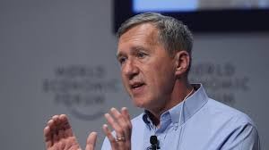
What is Machine Learning?
Tom Mitchell :
"A computer program is said to learn from experience E with respect to some class of tasks T and performance measure P, if its performance at tasks in T, as measured by P, improves with experience E."
“Machine Learning is concerned with computer programs that automatically improve their performance through experience.”

Slide 12
What is Machine Learning?
Tom Mitchell :
"A computer program is said to learn from experience E with respect to some class of tasks T and performance measure P, if its performance at tasks in T, as measured by P, improves with experience E."
Example: playing checkers.
E = the experience of playing many games of checkers
T = the task of playing checkers.
P = the probability that the program will win the next game.

Slide 13
What is Machine Learning?
Suppose your Email program watches which emails you do or do not mark as spam , and based on that learns how to better filter spam. What is the task T in this scenario?
Classifying emails as spam or not spam.
Watching you labels emails as spam or not spam
The number(fraction) of emails correctly classified as spam or not spam.
None of the above : This is not a machine learning problem

Slide 14
What is Machine Learning?
Suppose your Email program watches which emails you do or do not mark as spam , and based on that learns how to better filter spam. What is the task T in this scenario?
"A computer program is said to learn from experience E with respect to some class of tasks T and performance measure P, if its performance at tasks in T, as measured by P, improves with experience E."
Classifying emails as spam or not spam.→ T
Watching you labels emails as spam or not spam →E
The number(fraction) of emails correctly classified as spam or not spam.→P
None of the above : This is not a machine learning problem

Slide 15
What is Machine Learning?
Examples
i) Handwriting recognition learning problem • Task T : Recognising and classifying handwritten words within images • Performance P : Percent of words correctly classified • Training experience E: A dataset of handwritten words with given classifications
ii) A robot driving learning problem • Task T : Driving on highways using vision sensors • Performance measure P : Average distance traveled before an error • Training experience E: A sequence of images and steering commands recorded while observing a human driver
iii) A chess learning problem • Task T : Playing chess • Performance measure P : Percent of games won against opponents • Training experience E: Playing practice games against itself

Slide 16
What is Machine Learning?
Me
Parry
What?
Parry: Well, Ok! But how do machines experience ? They are not humans!
Me: Yes, Data :) Experience E corresponds to historical Data. Task T is to hit the bulls eye in one go and P is the number of pins you drop in one go!
Parry: Hmm, but what do you mean by learn? Machines don’t have brain as well.
Me: Exactly, this is where MATHEMATICS comes into picture! Machines learn by some complex mathematics concepts, every data for them is in the form of 0 and 1.
We don’t want to code the logic for our program instead we want a machine to figure out logic from the data on its own.

Slide 17
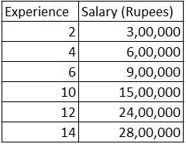
What is Machine Learning?
Me
Parry
Parry: What do you mean that we do not need to code the logic?
Me: We do not have to write hardcode rules as we write in any other programming language. For example: Suppose I have this small data about Payroll of employees in the company:
Now if you need to find something from this data, what can you infer?
Parry: I can observe that when experience is less than equal to 10 years, the person is getting salary x 1.5 times the experience and this factor increases to 2 when the experience increases from 10 years.
Me: Correct how will you code this? Say if you need to predict the salary for a person with 8 years and 16 years of experience?

Slide 18
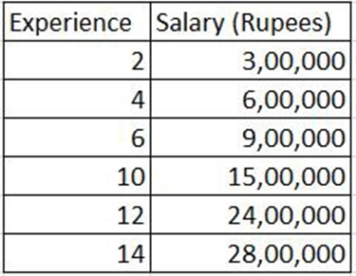
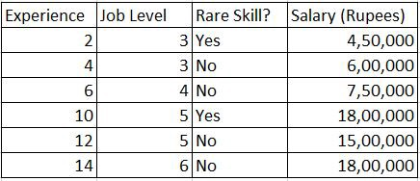
What is Machine Learning?
Me
Parry
Parry: But this was pretty easy, even I could figure out the relations in the data.
Me: Well when the scale of the problem increases
if (experience < = 10)
{ salary = experience * 1.5 * 100000}
else if(experience >10)
{ salary = experience * 2 * 100000}
Now, can you find relation between experience, job level, rare skill and Salary?
Me: We don’t do this here! We don’t write if, else in ML as we are not focused on writing Algorithms.

Slide 19
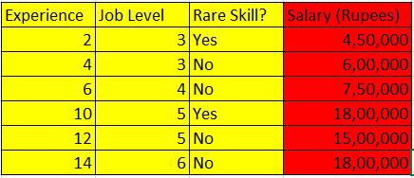
What is Machine Learning?
Me
Parry
Parry: It is kind of difficult now!
Me: This is where machines come into picture! The factor of 1.5 or 2 which you just calculated in previous example is called weight
Use Machine Learning to find out how much salary of an employee is dependent on Experience, Job Level and Skill
The columns in yellow are called features and the column in red is called label.
So we calculate weights of features that contribute in deciding the label.
Salary = Experience * Magic_Number_1 + JobLevel * Magic_Number_2 + Skill * Magic_Number_3

Slide 20
What is Machine Learning?
Me
Parry
Parry: But you only said we do not code the Algorithm and our focus in on the data.
Me: Actually Data + Algorithm = Insights. Algorithms are already developed for us and we need to know which Algorithm to use when. This was just intuition of one type of Machine Learning, the field is too big with lots of maths :)

Slide 21
Why Machine Learning?

Slide 22


Why Machine Learning?
Me
Parry
Me: How many hours do you use Facebook daily?
Parry: about 1 hour daily.
Me: Do you know Facebook is using Machine Learning to tag your friends in your uploaded picture? Do you know Facebook shows custom video recommendations based on your interest history?
Parry: Ohh! So is this the reason not all news feeds are same?
Me: Exactly, Facebook knows your likes and dislikes based on historical data and ML ofcourse :).

Slide 23
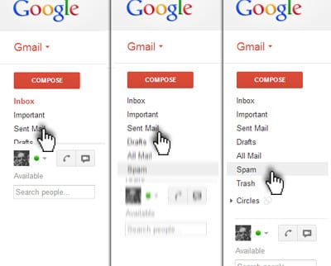

Why Machine Learning?
Why Machine Learning?
Me
Me
Parry
Me: Which mailbox you are using?
Parry: I am using Gmail.
Me: Do you know how does gmail knows that a particular mail has to go to priority, social, promotion or spam box ?
Parry: Obviously your machine learning!
Me: Yaa, it has millions of emails tagged by the users in a particular category. So by use of ML they observe the patterns and classify accordingly. Even the keyboard you are using today uses ML to predict your next word.

Slide 24

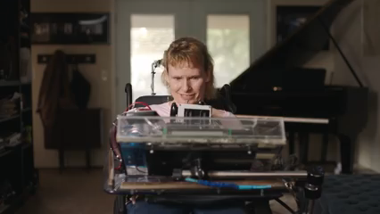
Why Machine Learning?
Me
Parry
Parry: So is it? Are we providing data to Google everytime we type in? Me: Yep, and google is doing some amazing things with that! One such example was in Google IO 2018. Have a look.
Parry: Great! So google incorporated Morse Code into Google Keyboard and it knows the conversions now due to presence of large translated data. Me: Yup!

Slide 25

Why Machine Learning?
Me
Parry
Me: Which website do you use for shopping?
Parry: Amazon! Its amazing! Me: Its amazing but most amazing thing is the amazon’s recommendations!
Parry: So very like we have video recommendations, we have product recommendations using Machine learning? Me: Exactly, but the conversion rate here matters a lot. Amazon’s recommendation engine has fetched it almost a revenue of 35 billion dollars!

Slide 26
Why Machine Learning?
Me
Parry
Me: So where are we watching the video?
Parry: YouTube ofcourse! and again are you giving me example of recommendations in youtube? Me: No this time a bit difficult! You know how much content in hours is uploaded on youtube in 1 minute? Take a wild guess
Parry: Hmmm! 10? Me: It is close to 500 hours! Do you think YouTube has this much staff so that they can review this much content for nudity, violence and copyright?
Parry: Omg! No not at all! Me: When scale of problem increases and we have more data, it turns out machines are only our last hope that is why we need Artificial Intelligence!
Parry: Great! but all those companies are big 4, my company will never use this technology so why is this more important now! Me: Machine Learning is not just a buzzword but an amazing technology that can see such things which are not visible to naked eye.

Slide 27
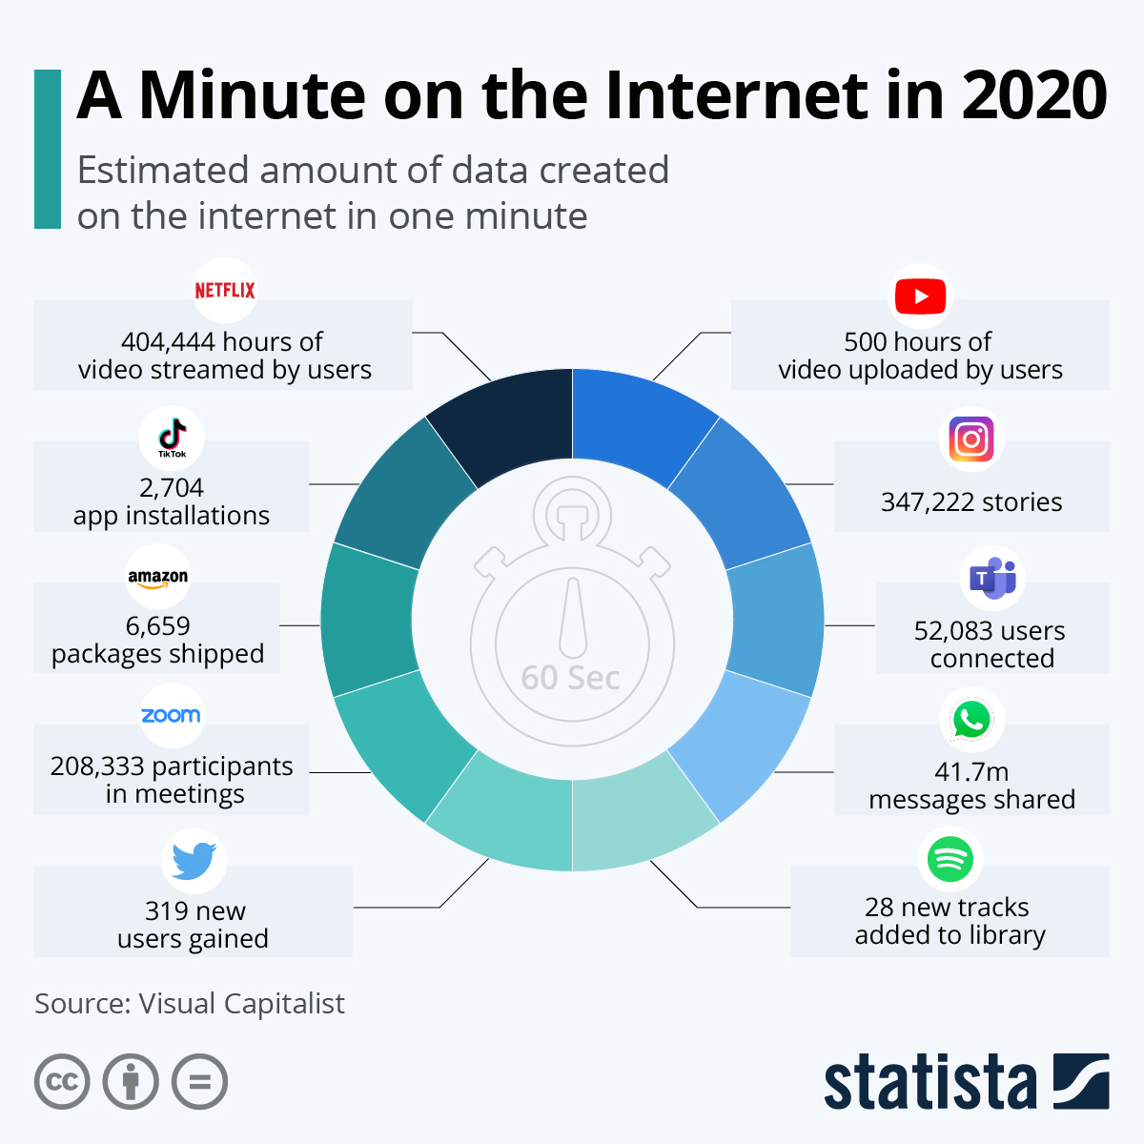
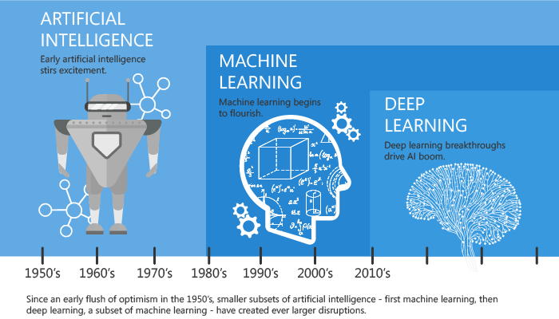
Why Now?
Flood of available data (especially with the
advent of the Internet)
Increasing computational power
Growing progress in available algorithms and theory developed by researchers
Increasing support from industries
Image: Linked In | Machine Learning vs Deep learning

Slide 28
Traditional vs ML
Data –> Information
Definitive cases
Eg: Matrix multiplication
Data –> Knowledge
Deals with Uncertainty
Eg: Next word prediction

Slide 29
Machine
Machine can | Machine cannot
Forecast | Create something new
Memorize | Get smart really fast
Reproduce | Go beyond their task
Choose best item | Kill all humans

Slide 30
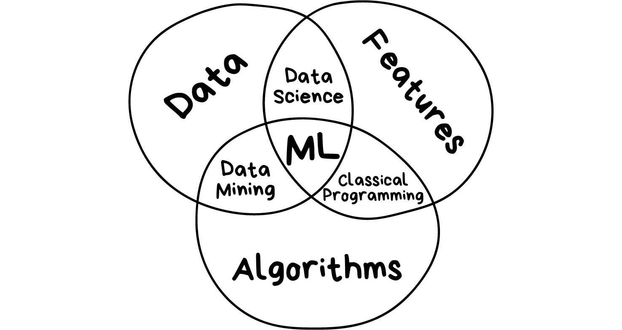
Components of Machine Learning

Slide 31
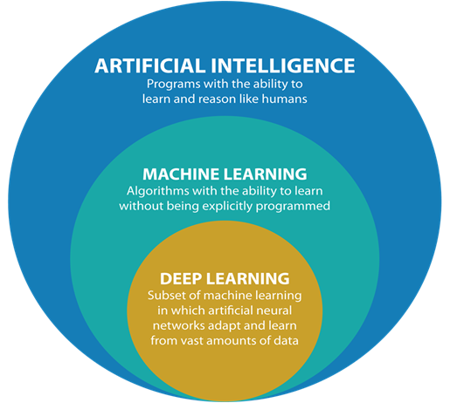
AI and ML
AI is the study of how to train the computers so that computers can do things which at present human
can do better
ML is an application of AI that provide system the ability to automatically learn and improve from experience.

Slide 32
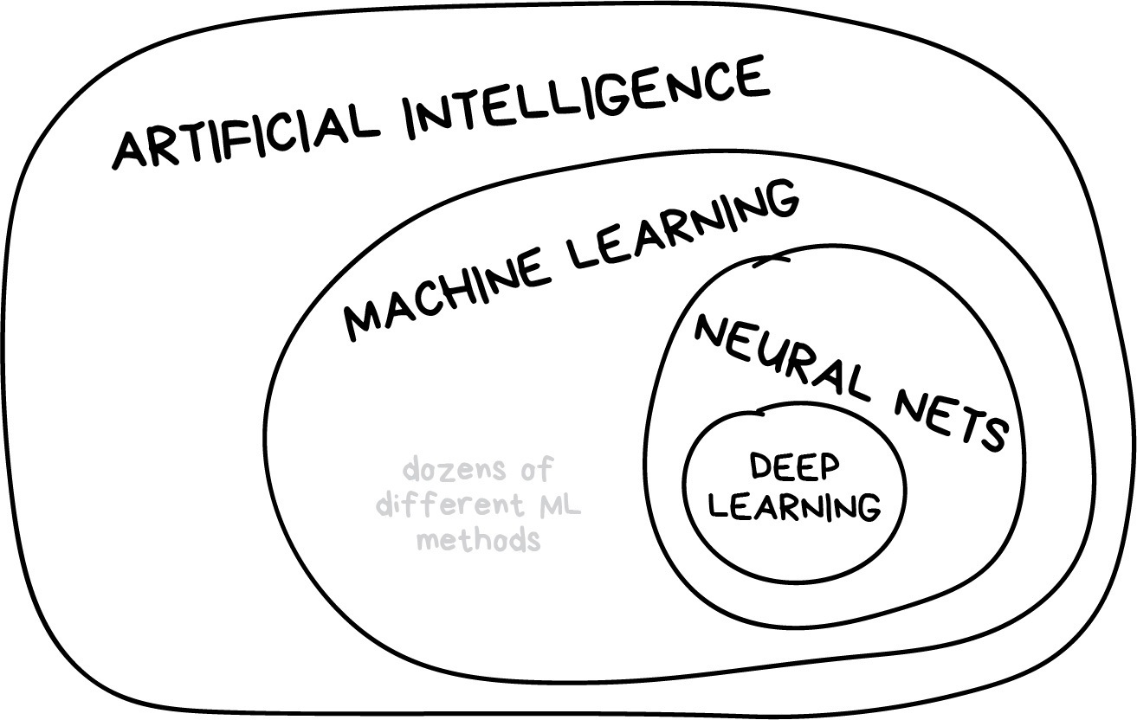
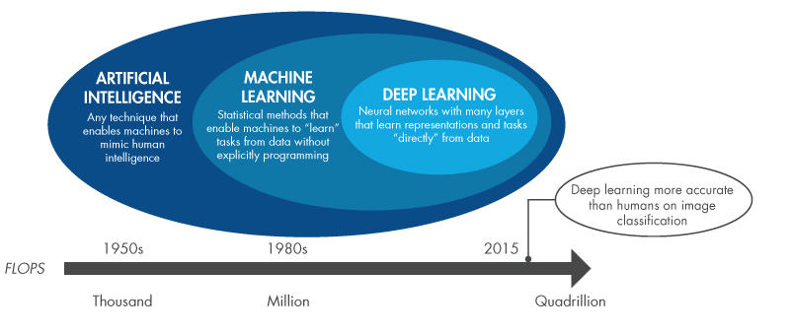
Learning vs Intelligence
Artificial intelligence | The name of a whole knowledge field, similar to biology or chemistry.
Machine Learning | A part of artificial intelligence
Neural Networks | Are one of machine learning types
Deep Learning | A modern method of building, training, and using neural networks
"will neural nets replace machine learning" sounds like "will the wheels replace cars".

Slide 33
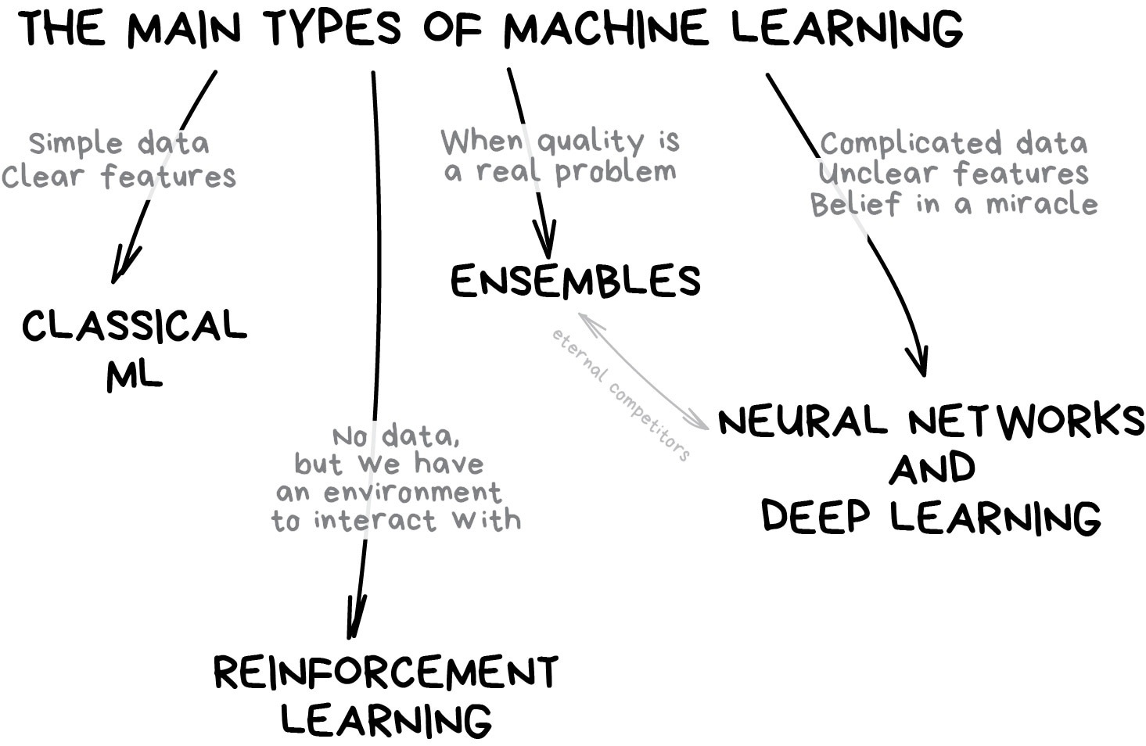
Main directions in machine learning

Slide 34

Classical Machine Learning

Slide 35
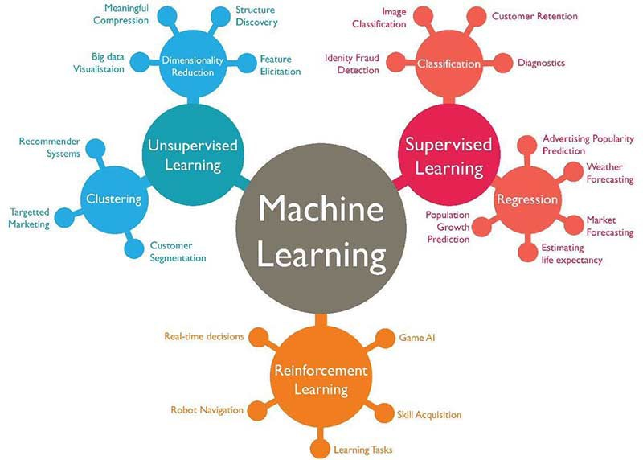
The map of the machine learning world

Slide 36
Keynote Address(Google I/O '18)
The latest product and platform innovations at Google in a Keynote led by Sundar ☺
https://www.youtube.com/watch?time_continue=1257&v=ogfYd705cRs
Amazon Go - a new kind of store featuring the world’s most advanced shopping technology
“No lines, no checkout – just grab and go!”
https://www.youtube.com/watch?v=NrmMk1Myrxc

Slide 37
THANK YOU

